Slide 1


Student Support Services Overview

Slide 2
Student and Institutional Benefits
Assist students in understanding LMS functionality and navigation
Remind students of important milestones and deadlines
Refer student issues to UF support services when appropriate
Assist students in navigating and understanding institutional processes
Our Program Coaches are the constant in the online experience for students

Slide 3




Who We Are
Embanet believes in the mission of traditional not-for-profit universities, and partners with these institutions to attract and retain students through the delivery of high quality online degree programs.
We are the preeminent full-service provider of online learning services to colleges and universities:
130+ Degree programs supported across 36 University Partners
80+ Technical Services Clients
600+ Employees
Offices in Chicago + Orlando + Toronto

Slide 4























130+ Programs Across 36 University Partners
Embanet Academic Partners include:
8 of the 62 AAU Institutions and
21 of the Top 200 USNWR Nationally Ranked Universities 2013

Slide 5


Discipline-Specific Delivery
Cross Functional Program Team
Dedicated Program Team
Aligned Culturally
Transparent
to the University
Invisible to the Students
Finance
Technology
Technology
Marketing
Finance
Managing
Director
Marketing
Manager
Marketing
Services
Pearson Digital Content
Enrollment
Coach
Content
Program
Coach
Recruitment
Instructional
Services
Recruitment
Services
Student Support
Student Support
Services

Slide 6
Who is Student Support Services?
We are a team of dedicated, passionate professionals in the online student space
We do not believe in a “one size fits all approach”
We believe that a strong partnership between our team and our University Partners is critical to student success
We are dedicated to continuous improvement of both our processes and our people
We have dedicated support for the students from acceptance to graduation

Slide 7

Recruitment Handoff to Student Support Services
Program Management
Recruitment
Student Support
Understand the needs of the students
Red Flag Process
Welcome and Onboard
One Team
Warm Handoff

Slide 8
Communication Objectives
All touch points are focused on optimizing student satisfaction and success
Student
Proactive
Registration Activities
Re-engagement
Reactive
At-risk

Slide 9

Communication Plan Categories
NEW STUDENTS
Students in their first term
RETURNING STUDENTS
Students in their
2nd through last term
AT-RISK STUDENTS
Students who show predetermined risk factors
Require a high touch with predetermined touch points
Require less frequent touch points
Require close monitoring and frequent touch points

Slide 10
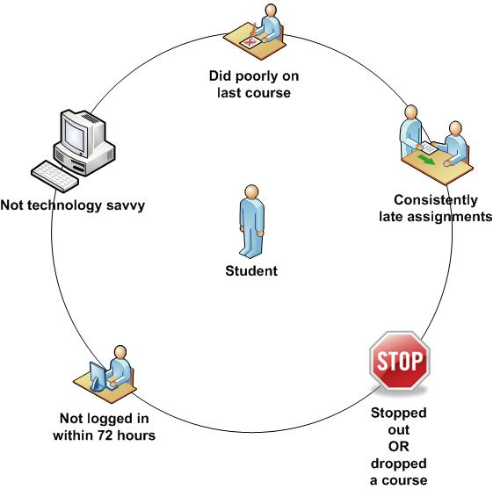
At-Risk Indicators
Technology
As historical data for the program and other programs are collected, custom at-risk indicators will be added.
Finance
Marketing
Instructional
Design
Recruitment
Student Support

Slide 11





Retention Focused Student Support Communication
Every student is supported by a dedicated Student Support Contact:
 | Upon Acceptance | Registration Opens | 1 Week Prior to Course | Week 1 of Course | Week 3 of Course | Every 60 Days
New Students | Welcome Call or Webinar & Welcome Packet | Registration Reminder | Check in Call | Check in Call | Check in Call | Check in Call
Returning Students |  | Registration Reminder | Check in Call & Email |  |  | Check in Call
At- Risk Students |  | Registration Reminder | Check in Call & Email | Check in Call | Check in Call | Check in Call
 | Student Support Timeline Calls, Emails and Activities. Cross Functional communication and ongoing communication with the University. Alternative communication includes postal mail, webinars, web announcements, Skype and social networking.

Slide 12
Retention Measurement and Results
Term over term return rates:
90%
Course drop rates <10%
Focus and manage to planned course load
65%-85% graduation rates*
High academic partner satisfaction
New Student
New
Returning
(1st to 2nd Term)
Returning
(3rd Term and Beyond)
Graduation
*150% of marketed program length
Notes:
Academic Partners were asked to evaluate the services delivered by Pearson Embanet, specifically in the areas of Marketing, Recruitment, Student Support, Instructional Design, and Help Desk/Technical Support. The respondents rated their satisfaction on the five point scale ranging from Very Satisfied (5) to Very Dissatisfied (1). the highest rated services are Student Support (3.90),
We also manage the team to adhering to communication expectations with students, quality and accuracy of their communication to students and our APs.

Slide 13
Best Practices and Administrative Partnership
Defined Academic Calendar inclusive of course offerings for the entire student program length. Receive registration rosters regularly during registration period. Access to LMS and classrooms to identify at-risk students and protocol for intervention. Key process dates to promote persistence and deter students from dropping. Dedicated program and administration resources at the University to provide timely services to students and to ensure consistency in our approach to manage the program and student retention. Imbed institutional commitment in our process and communication.

Slide 14
Example Organization Structure
Sr. VP SSS
Orlando
Director
Manager of Academic Administration
BU 1
Associate Director
BU 2
Associate Director
BU 3
Associate Director
BU 4
Associate Director
BU 5
Associate Director
Quality Assurance Assistants
Roster Processing
Course Scheduling
Updates and Maintains Laurus (CRM)
Quality Checks
Manages Key Information
UF Online
Associate Director
Program
Coordinators
Primary Contact for AP SSS
Administrative Support
Creates and Manages Process Forecasting
Student Communication

Slide 15

How can I help you?

Slide 16
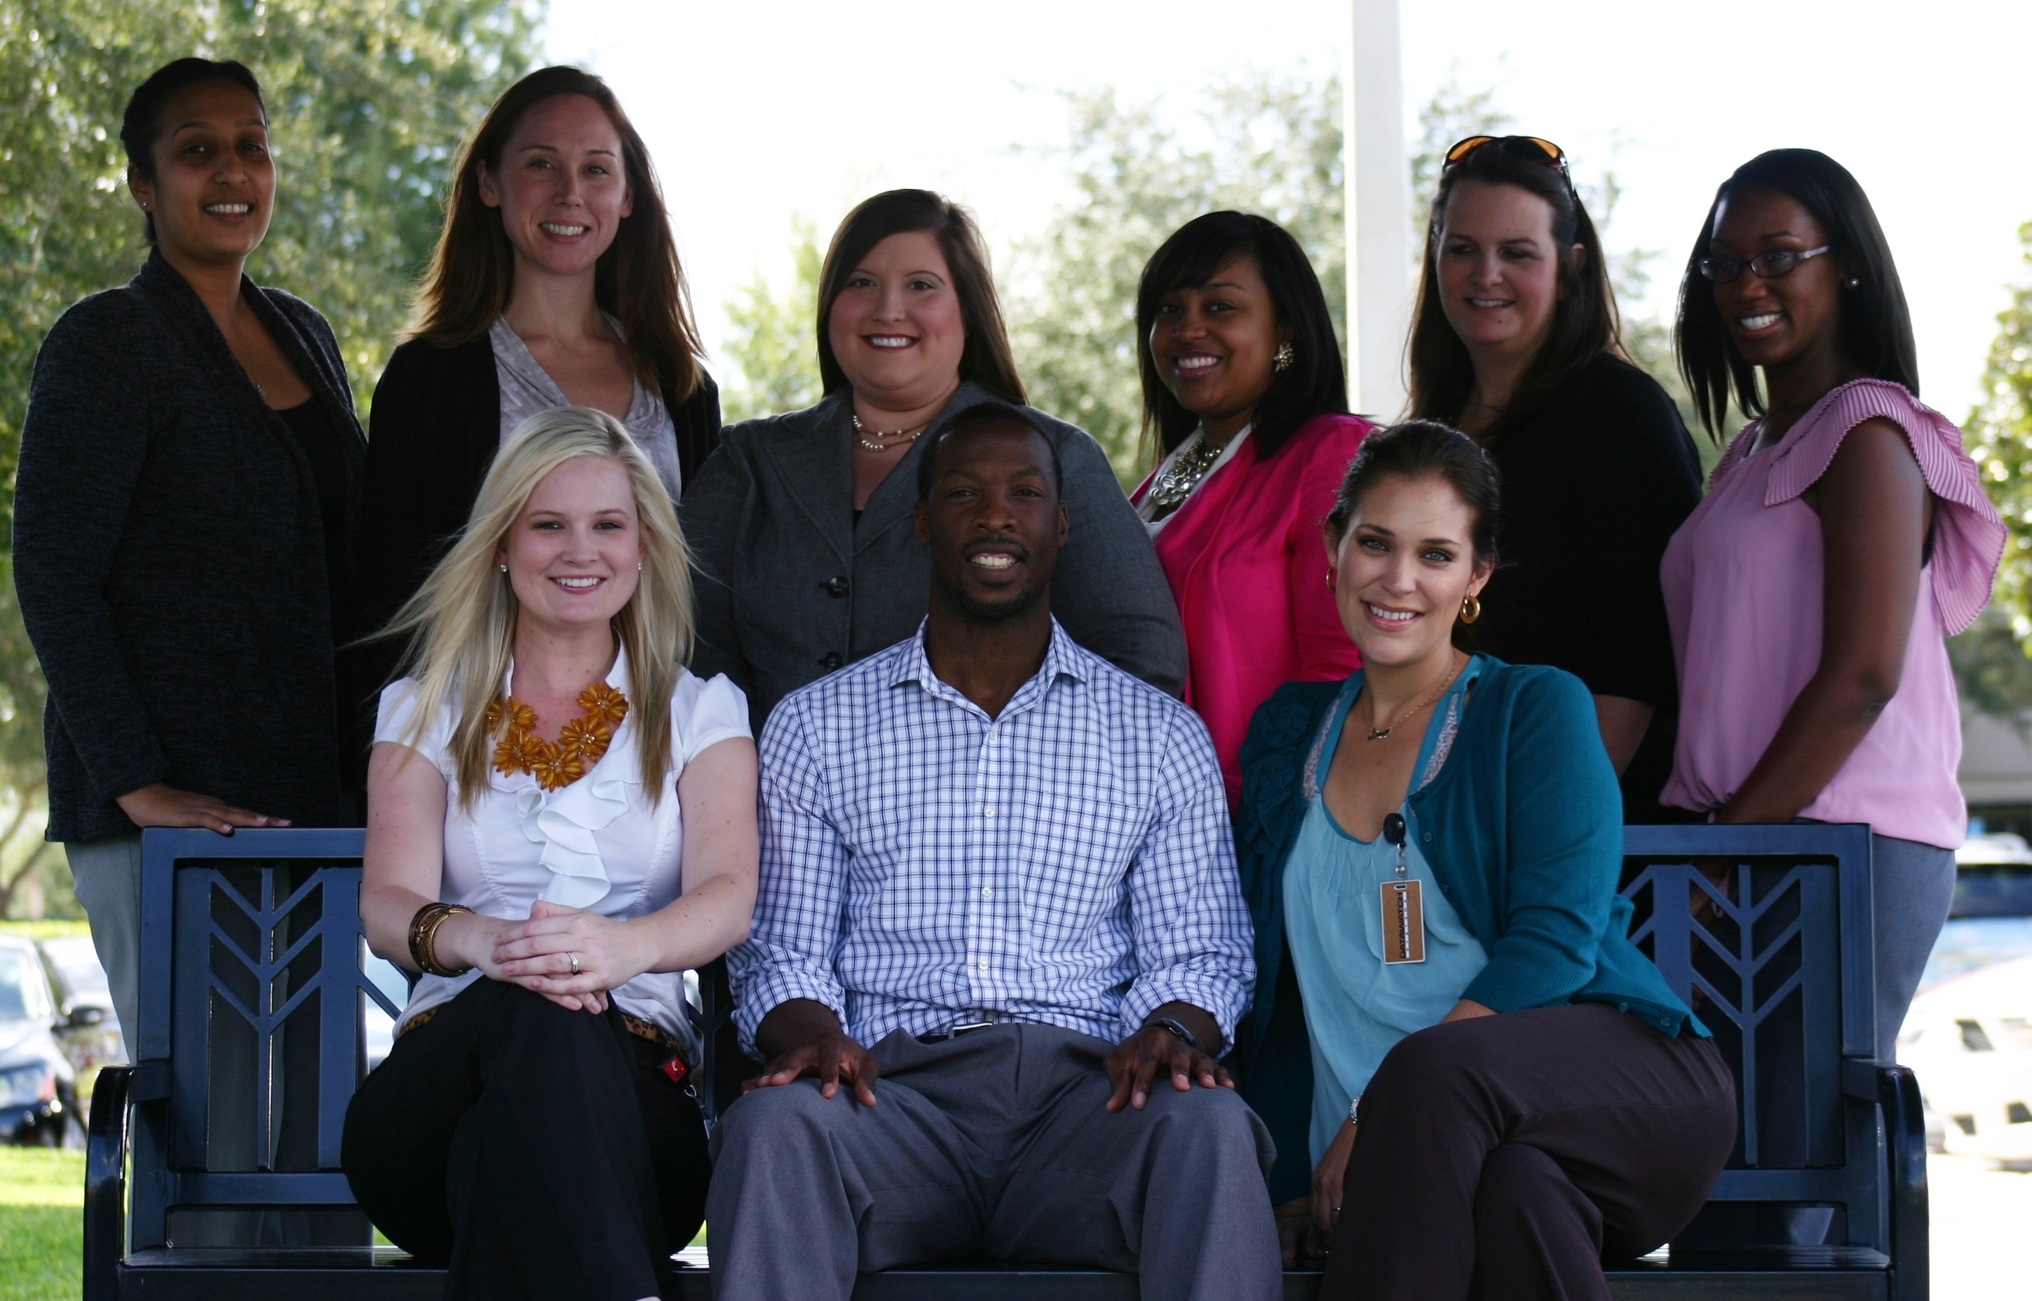
Thank You
Alan Coheley
Senior VP, Academic Partnerships
©2013 Pearson Embanet Confidential and Proprietary

